Slide 1


FINAL PROJECT
Subject: Machine Learning
Topic:
THE APPLICATION OF CNN MODEL
IN IMAGE CLASSIFICATION
Lecturer: Nguyen Son Lam
GROUP 05

Slide 2

GROUP MEMBERS:
1
Le Vuong Duy
2
Ho Dac Nguyen
3
Huynh The Nhiem

Slide 3
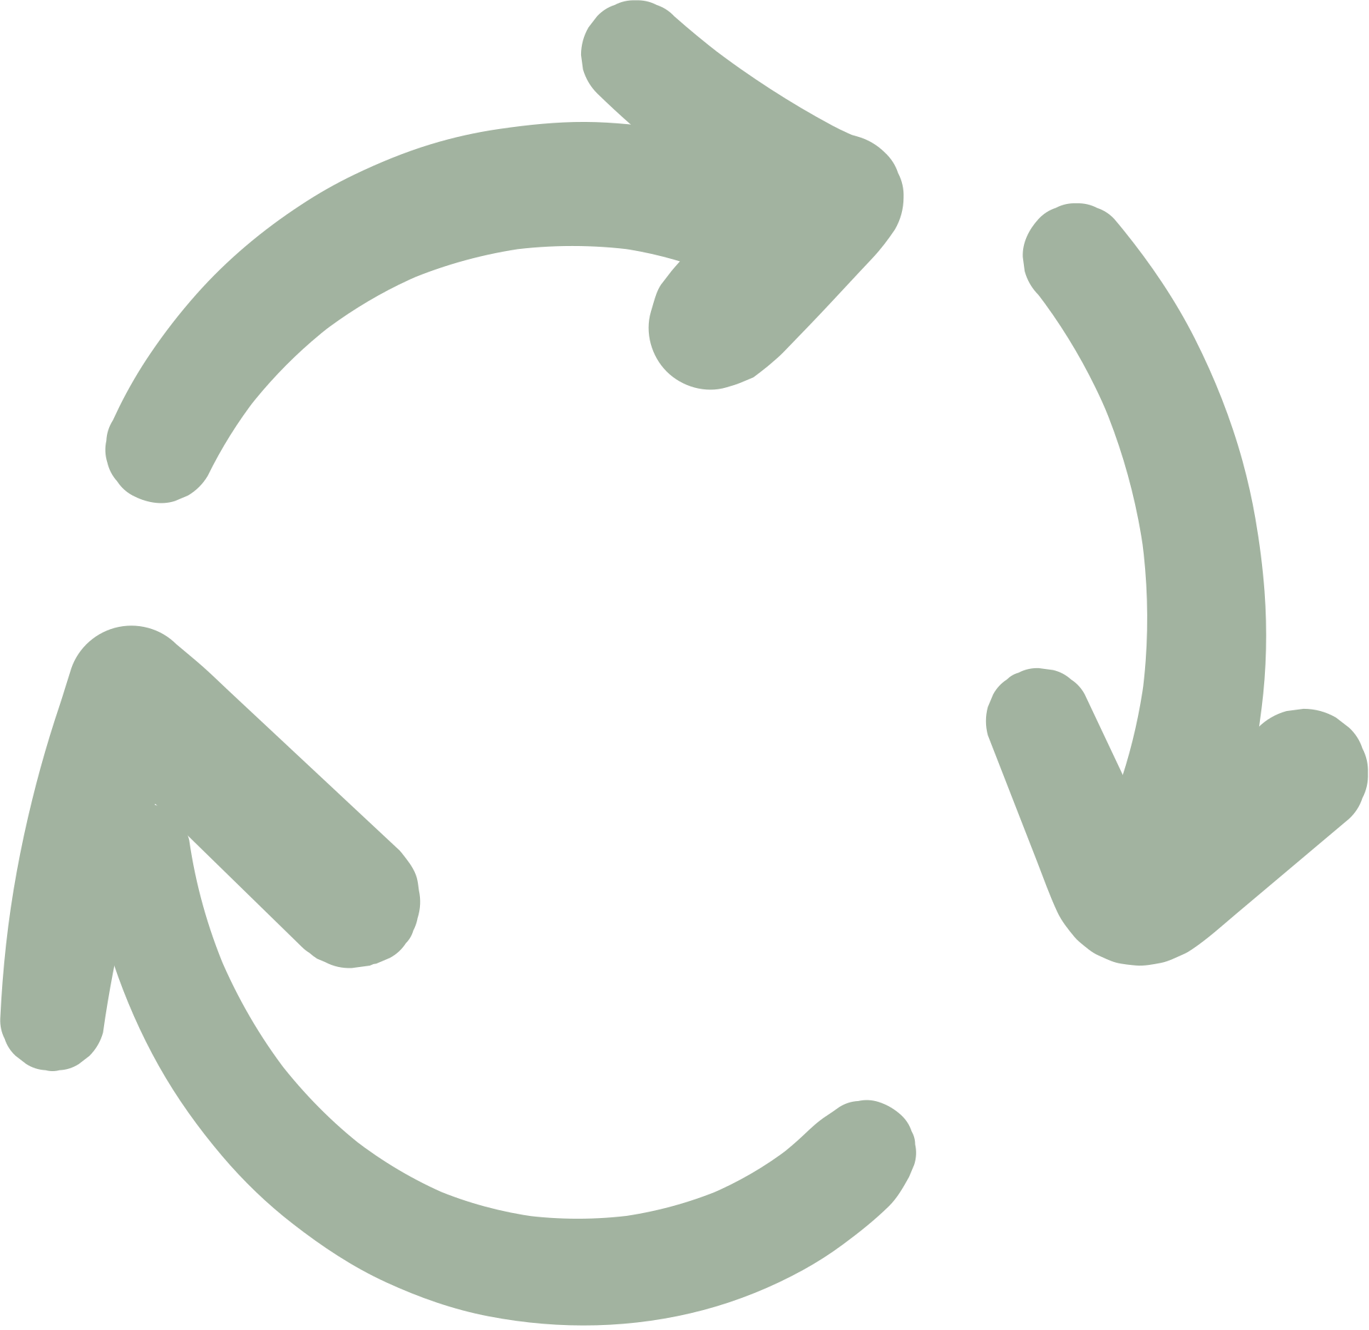



TOPIC
The application of CNN model in image classification

Slide 4

TABLE OF CONTENTS
I. The Overview
II. Carrying out the topic and obtained results
III. Conclusion and Development Direction

Slide 5
I. THE OVERVIEW

Slide 6
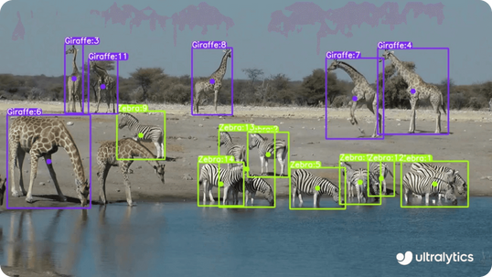
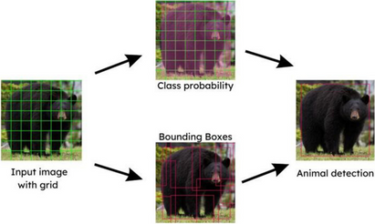
1. REASONS FOR CHOOSING THE TOPIC
High applicability: Automate animal identification and monitoring, effectively supporting nature conservation.
Practical implications: Solve wildlife data management, reducing costs and time compared to manual methods.
Research potential: Testing and improving CNN with diverse data sets, applying to real image classification.
Sustainable orientation: Contribute to protecting the ecosystem, raising conservation awareness, and applying technology for sustainable development.

Slide 7
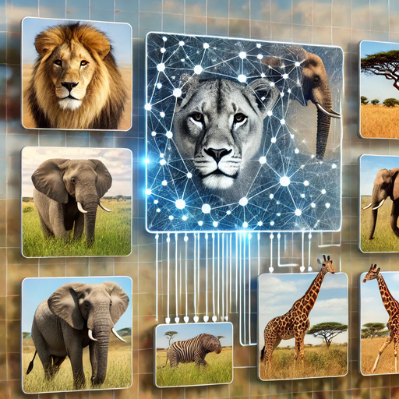
2. CNN MODEL IN IMAGE CLASSIFICATION
CNN (Convolutional Neural Network) is a powerful architecture in image classification and recognition. In the problem of classifying African wildlife, CNN helps identify species such as lions, elephants, and giraffes from natural images, contributing to effective conservation and monitoring.

Slide 8
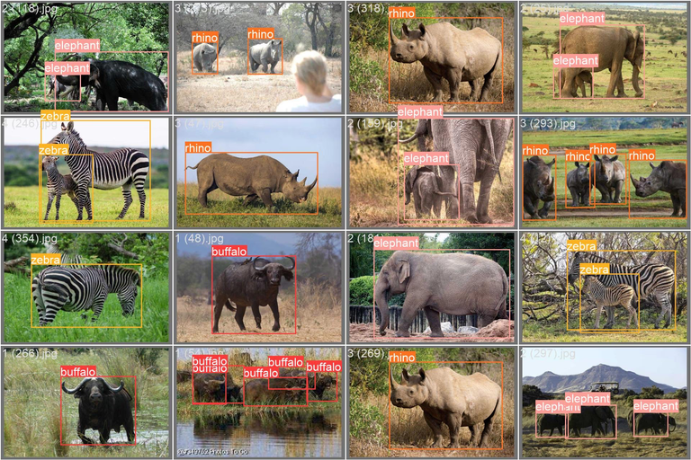

3. THE DATASET USED TO CARRY OUT THE PROJECT
The African Wildlife Dataset is used, which includes images of African wildlife with detailed captions. The data set is provided at Ultralytics, including instructions for processing and dividing the data to optimize model training.

Slide 9
II. CARRYING OUT THE TOPIC
AND OBTAINED RESULTS

Slide 10

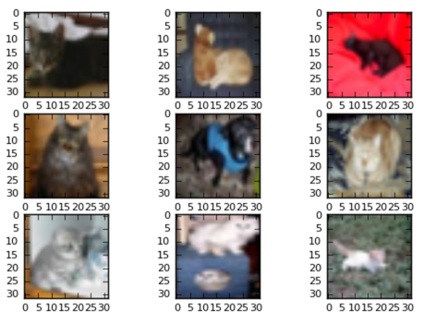
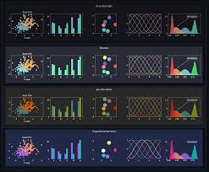
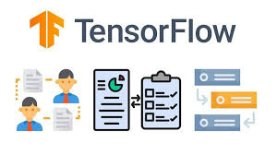
1. TECHNOLOGY USED
TensorFlow
ImageDataGenerator
Matplotlib

Slide 11
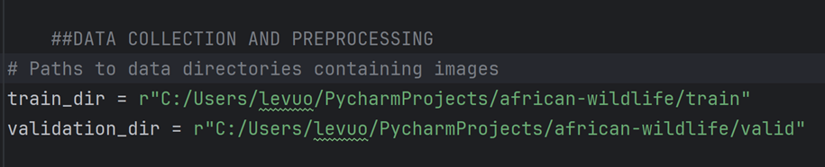
2. DATA COLLECTION AND PREPROCESSING
Feed the image dataset to train the model by inserting the path to the directory containing it

Slide 12
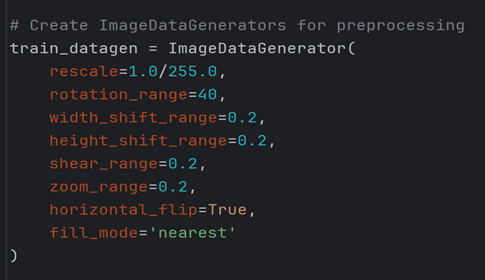
2. DATA COLLECTION AND PREPROCESSING
Initialize ImageDataGenerator for training set to augment data to generate more variations of images

Slide 13
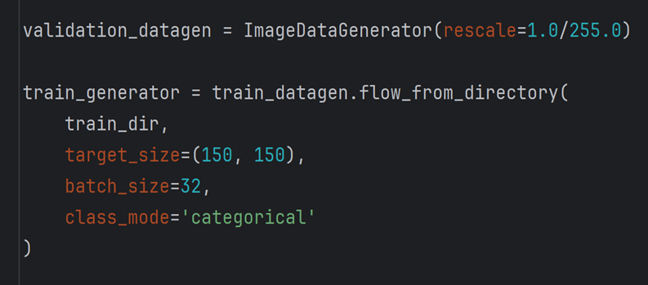
2. DATA COLLECTION AND PREPROCESSING
Normalize pixel values ​​to the range [0, 1] without applying other transformations

Slide 14
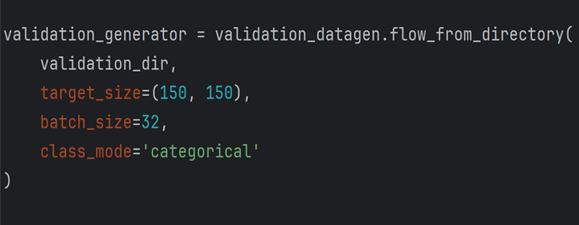
2. DATA COLLECTION AND PREPROCESSING
Creating a generator for the test set

Slide 15
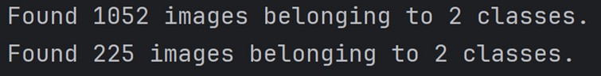
2. DATA COLLECTION AND PREPROCESSING
=> OUTPUT:
The number of images in the training data directory (train_dir) is 1052 images divided into 2 classes.
The number of images in the validation data directory (validation_dir) is 225 images divided into 2 classes.

Slide 16
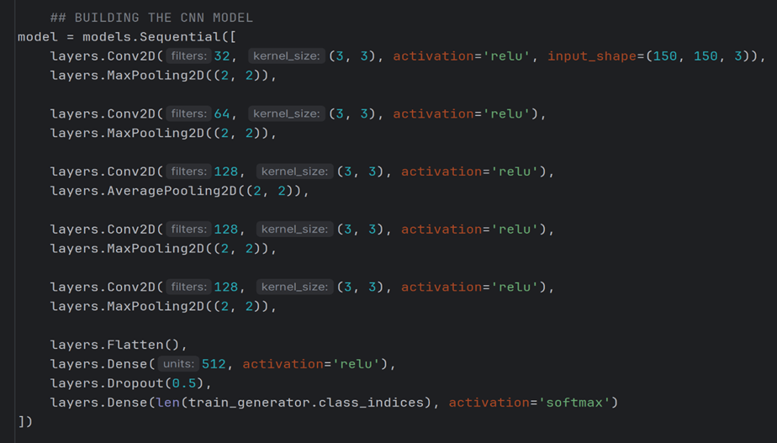
3. BUILDING THE CNN MODEL
Constructing the CNN (Convolutional Neuron Network) model with full convolutional layers, pooling (including max pooling and average pooling), and fully connected

Slide 17
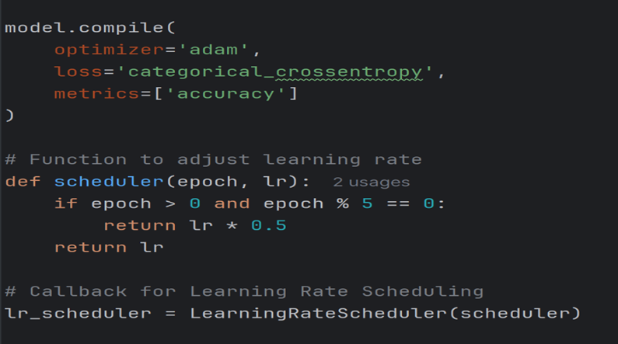
3. BUILDING THE CNN MODEL
Once the CNN model is fully built, it will be compiled to prepare for the training process and then the learning rate will be adjusted (Learning Rate Scheduling) with the scheduler function

Slide 18
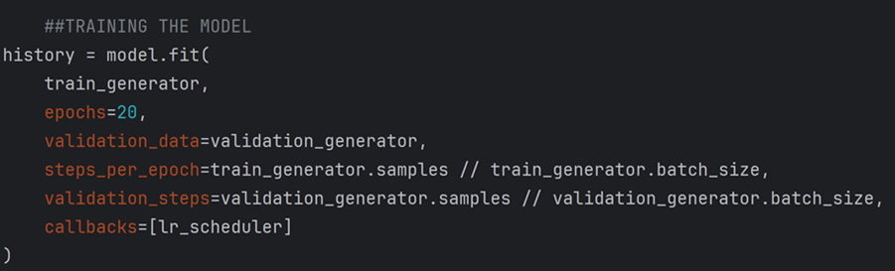
4. TRAINING THE MODEL
After building and compiling the CNN model, the model will be trained by using the TensorFlow/Keras library method

Slide 19
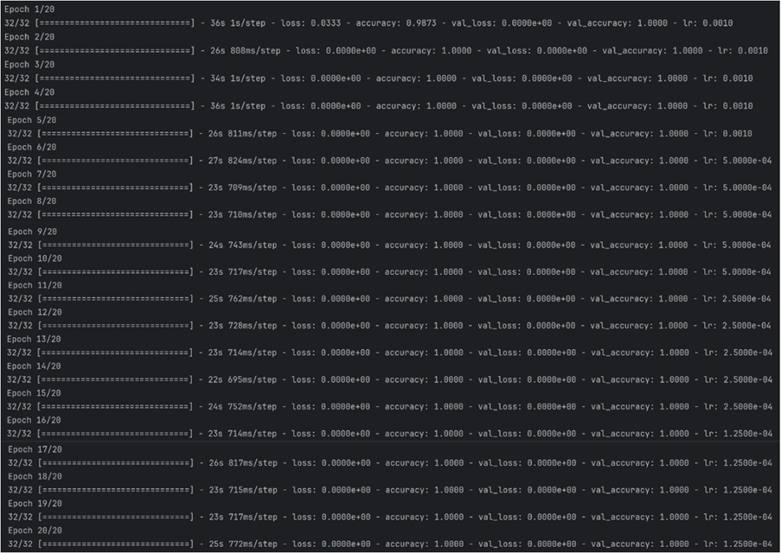
4. TRAINING THE MODEL
=> OUTPUT:

Slide 20
4. TRAINING THE MODEL
*THE DISCRIPTION FOR OUTPUT:
The training results with 20 epochs are as follows:
- Epoch 1:
+ Loss on the training set is 0.0340
+ Accuracy on the training set is 98.24%.
+ val_loss: 0.0000e+00, val_accuracy: 1.0000.
- Epochs 2 to 20:
+ loss = 0.0000e+00 and accuracy = 1.0000
+ val_loss = 0.0000e+00, val_accuracy = 1.0000
+ lr: Learning rate is gradually reduced in each interval (from 0.0010 to 0.000125)

Slide 21
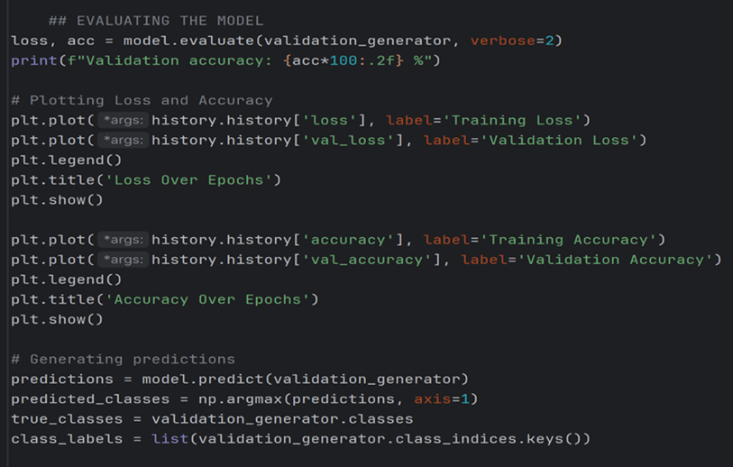
5. EVALUATING THE MODEL
Evaluating the model with the model.evaluate function with loss, acc on the test set, plotting the loss function and accuracy and making predictions from the model

Slide 22
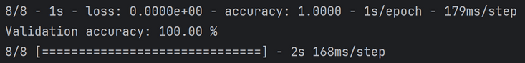
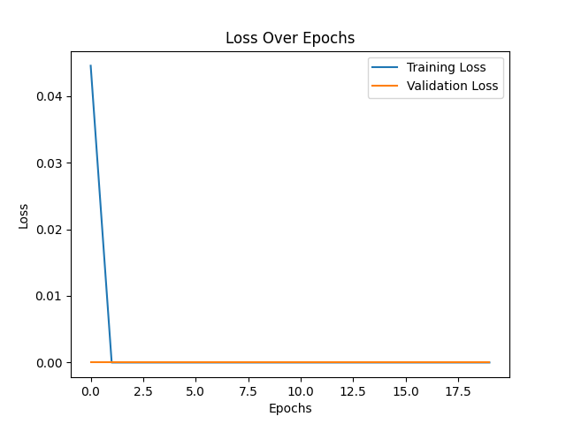
5. EVALUATING THE MODEL
=> The output of model.evaluate function and plotting the loss function:

Slide 23
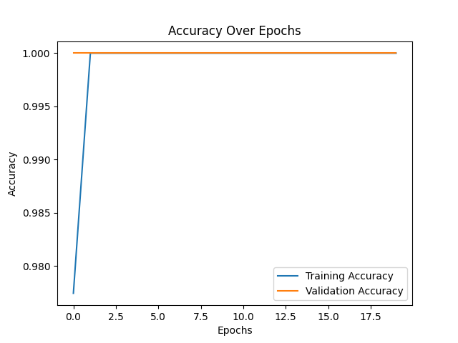
5. EVALUATING THE MODEL
=> The output of plotting the accuracy function:

Slide 24
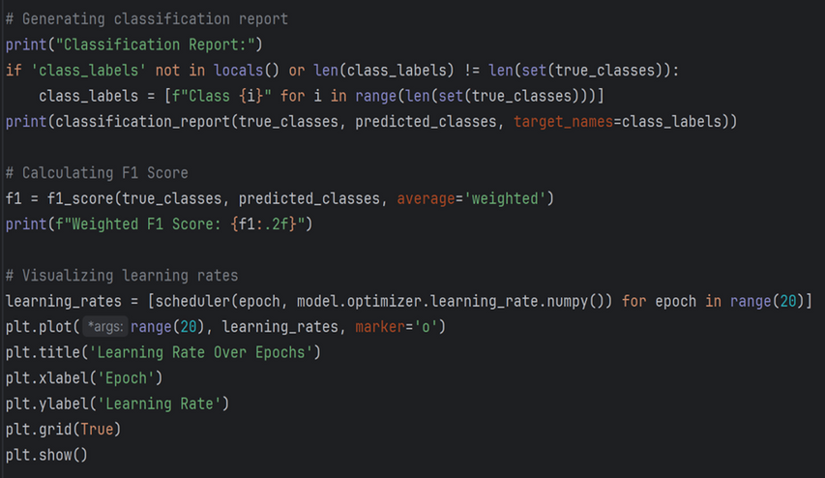
5. EVALUATING THE MODEL
Next, we evaluate the model by making a classification report (Classification Report), calculating F1 Scorel and showing the learning rate (Learning Rate)

Slide 25
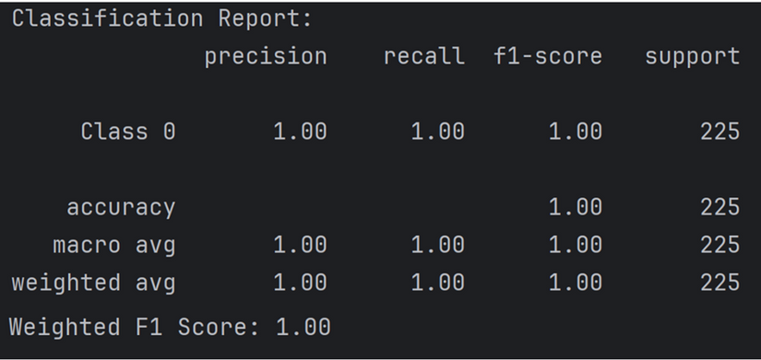
5. EVALUATING THE MODEL
=> The output of making a classification report (Classification Report), calculating F1 Score:

Slide 26
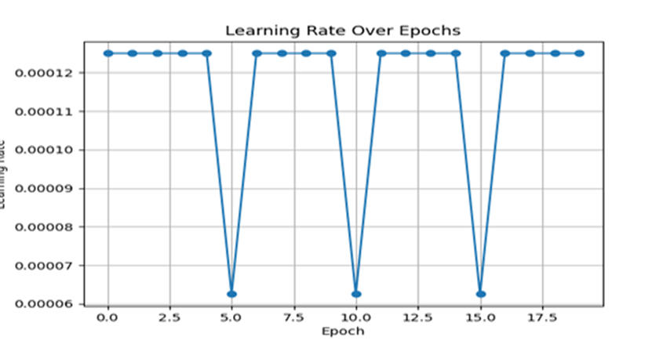
5. EVALUATING THE MODEL
=> The output of showing the learning rate (Learning Rate):

Slide 27
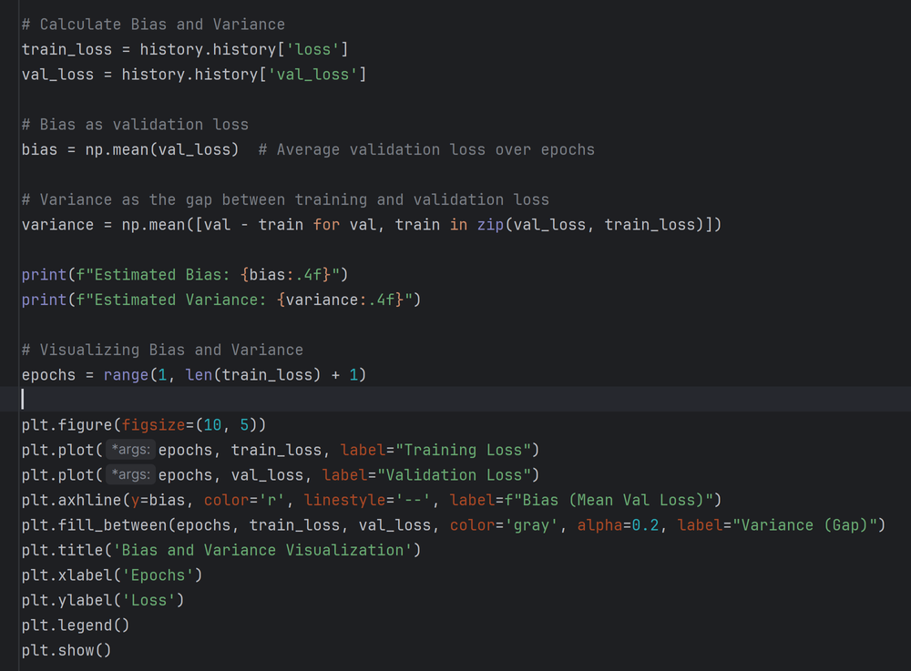
5. EVALUATING THE MODEL
In addition, we calculate Variance, Bias along with drawing the chart of variance, bias function in order to analyze the model performance and develop improvement strategies

Slide 28
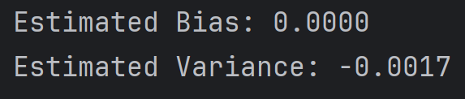
5. EVALUATING THE MODEL
=>THE OUTPUT OF CALCULATING VARIANCE& BIAS:

Slide 29
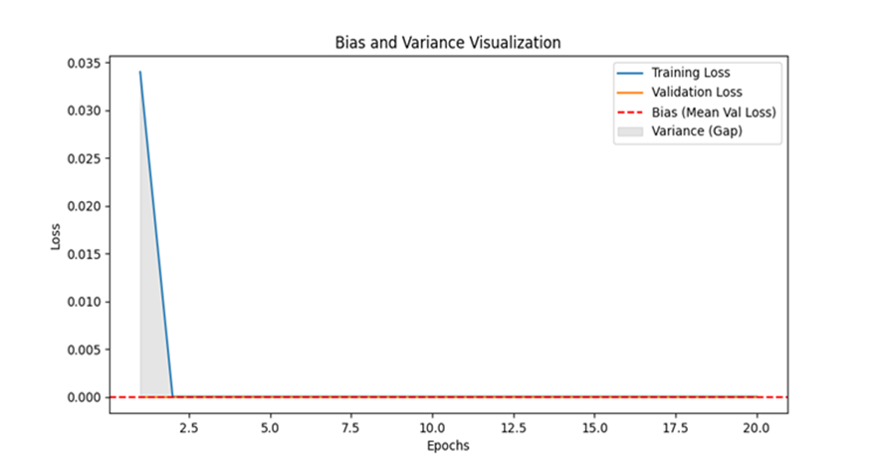
5. EVALUATING THE MODEL
=>THE OUTPUT OF DRAWING THE CHART OF VARIANCE, BIAS FUNCTION:

Slide 30
III. CONCLUSION AND
DEVELOPMENT DIRECTION

Slide 31
CONCLUSION
Project Objective: Develop an automated wildlife identification model.
Technology Used: Convolutional Neural Networks (CNN).
Results Achieved: Accuracy: 100% on the test dataset.
Practical Significance:
Ability to classify wild animals from images with high precision.
Potential applications in wildlife monitoring and conservation.

Slide 32
2. LIMITATIONS
Limited Dataset: Small dataset may hinder generalization to new species.
Overfitting Risk: High accuracy might reflect overfitting to training data.
Limited Species Diversity: Focused on a few species; broader application needs more data.
Real-world Applicability: Model tested in controlled settings; performance in field conditions is uncertain.

Slide 33
3. FUTURE DEVELOPMENT
Data Expansion: Gather a more diverse dataset from camera traps and citizen science to improve generalizability.
Architectural Refinement: Test advanced CNNs (e.g., ResNet, Inception, EfficientNet) for better accuracy and efficiency.
Multi-task Learning: Add tasks like object detection and instance segmentation to enhance functionality.
Real-world Deployment: Test in wildlife monitoring systems under varying real-world conditions.

Slide 34

THANK YOU!

